Slide 1
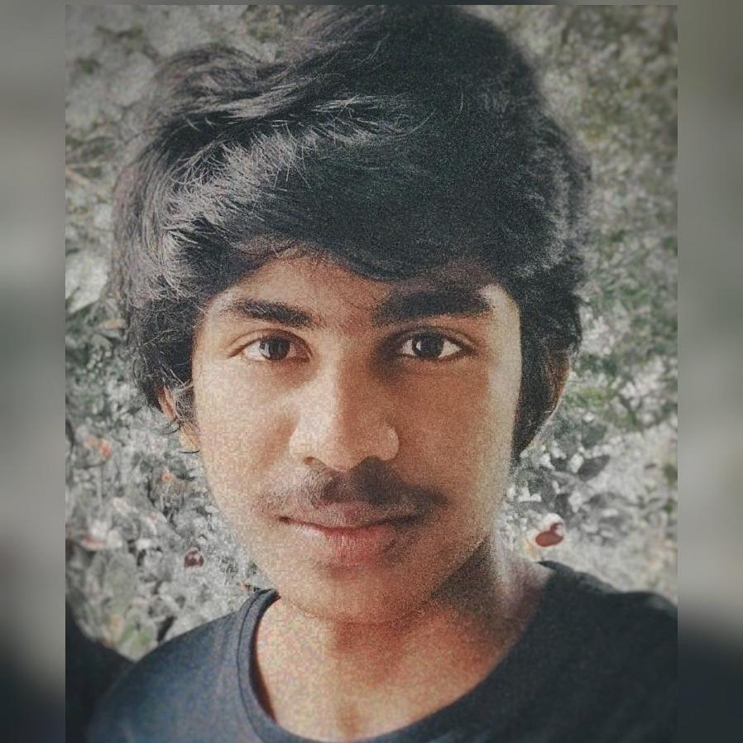
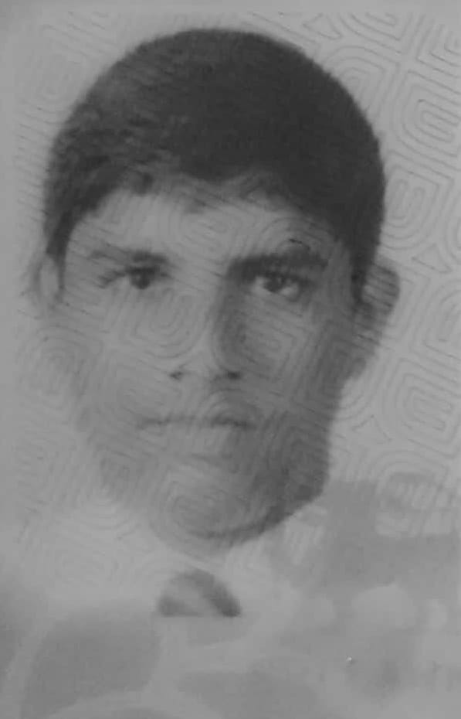
Team Poseidon
Leader
Harindu Fonseka
Member
Madusha Kolambage

Slide 2
Presentation Agenda
Team information and app intro
In App walkthrough
App marketing practices
Business model

Slide 3
Introduction
Micro rally is a mini simple multiplayer car game. Drift your way up in the sky in this skill-based driving game.
Face the challenges of unique theme maps with many colorful cars. Gain bonuses from daring tricks and collect coins to get maps and by leveling up you can reach even greater distances with a small fuel capacity.

Slide 4
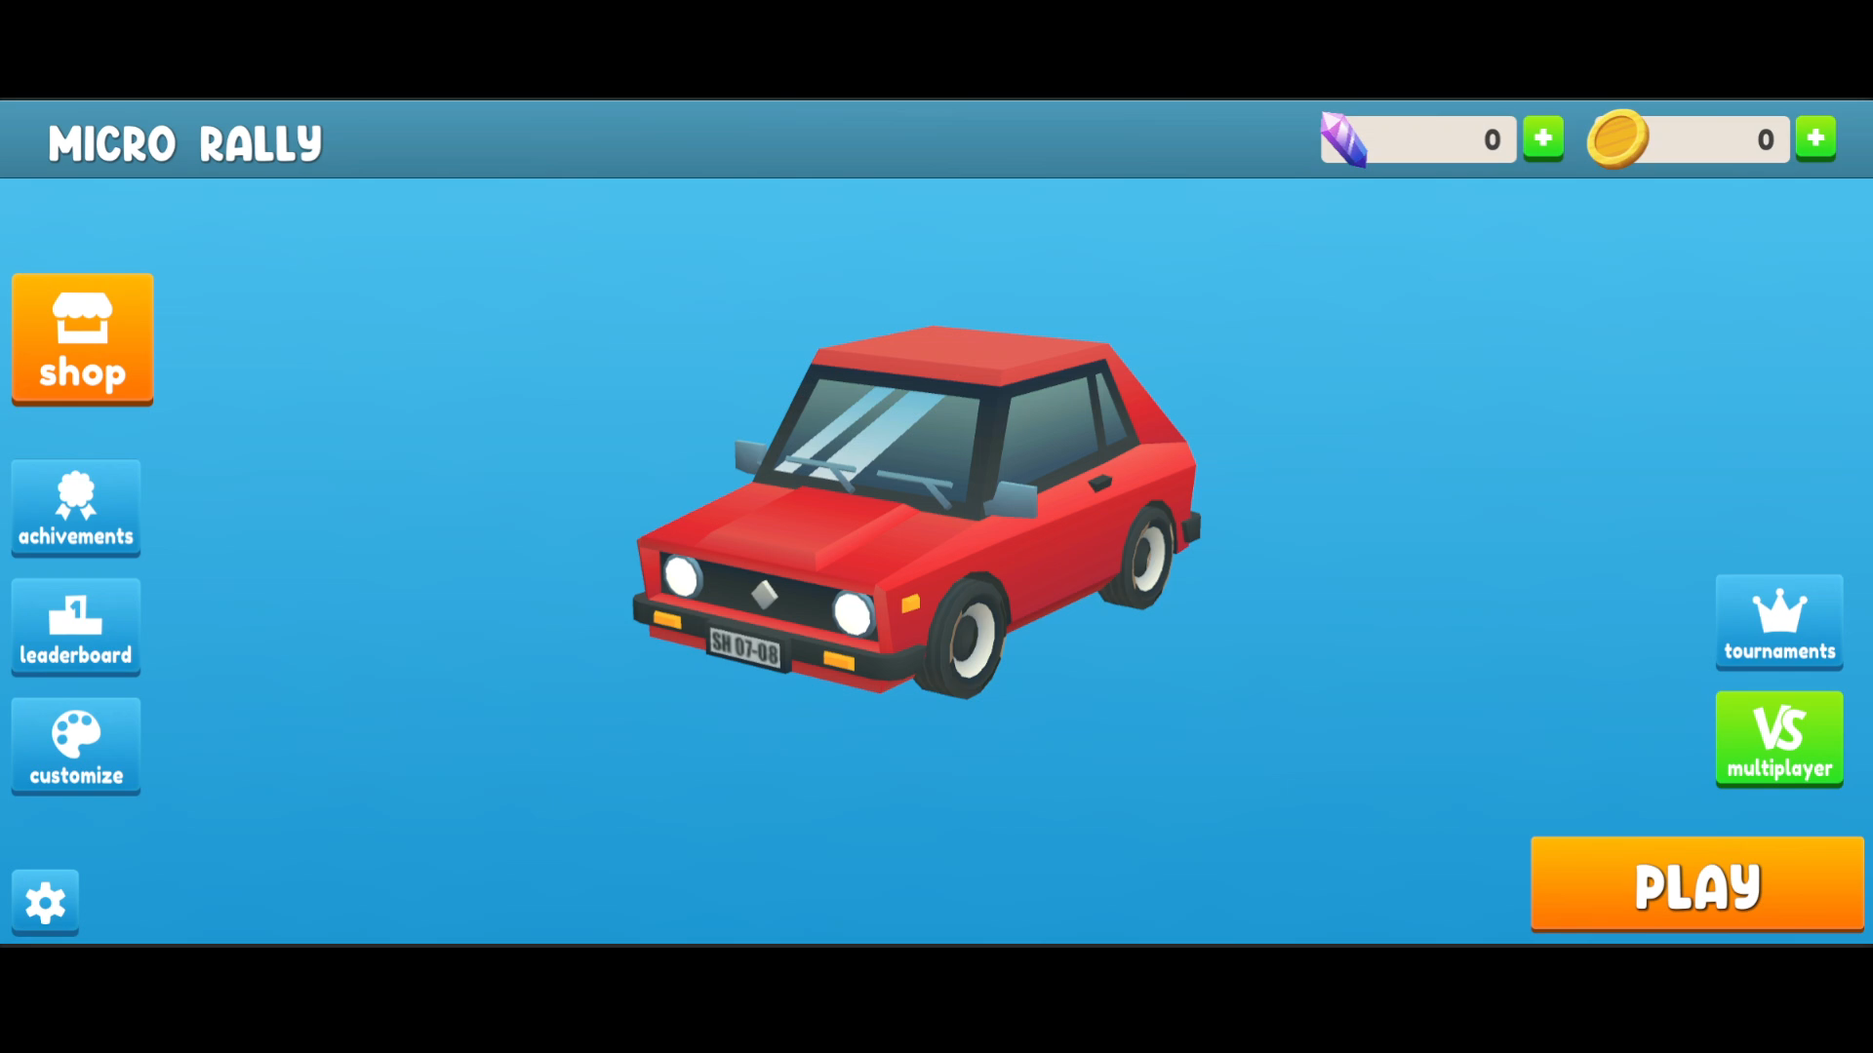
In app walkthrough

Slide 5
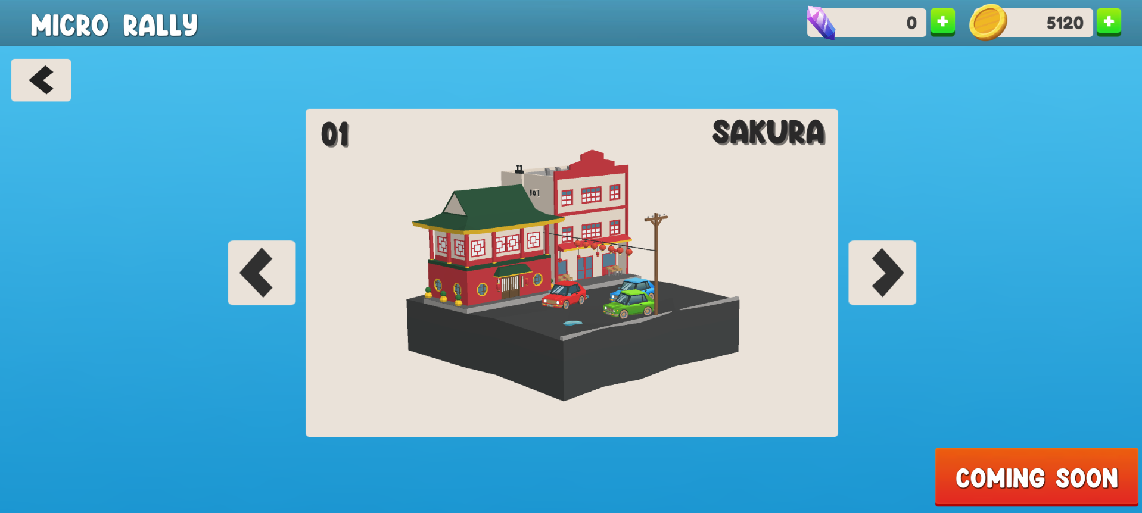
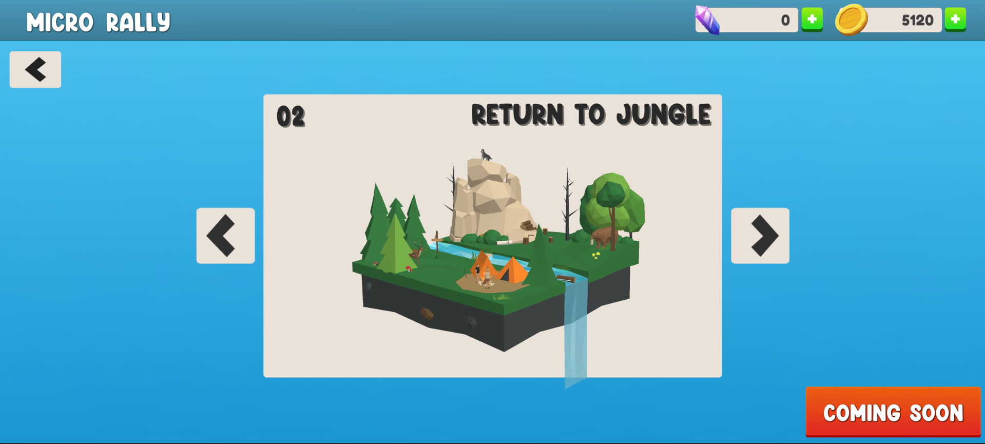
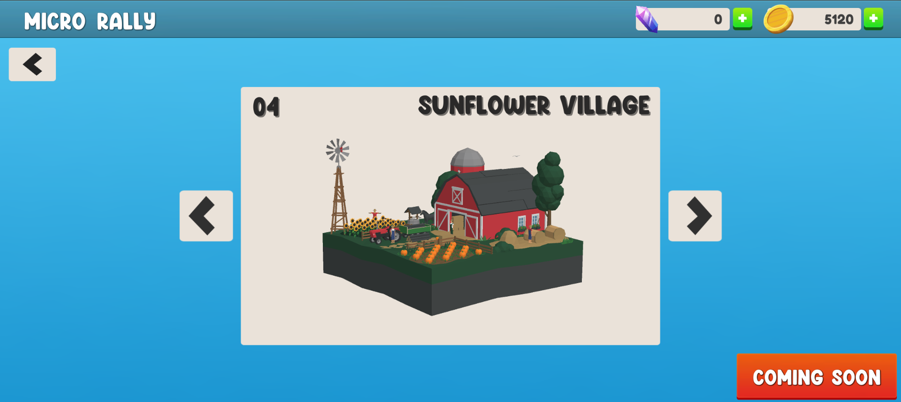
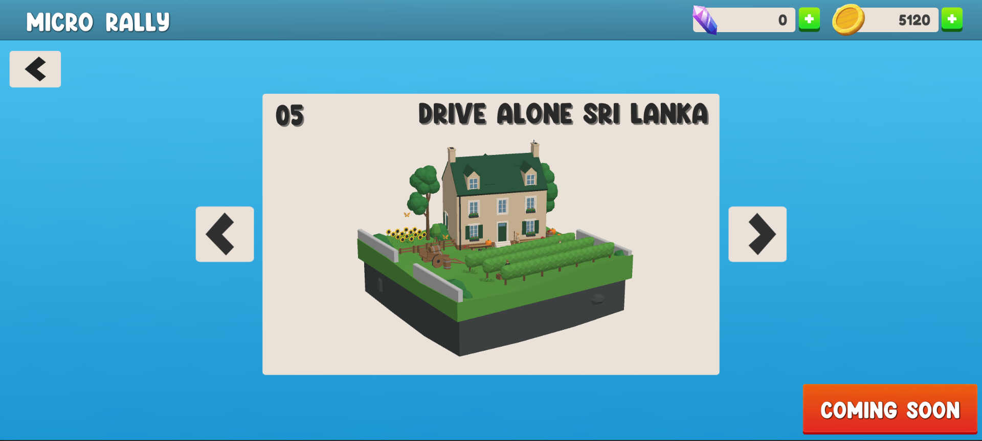
In app walkthrough

Slide 6
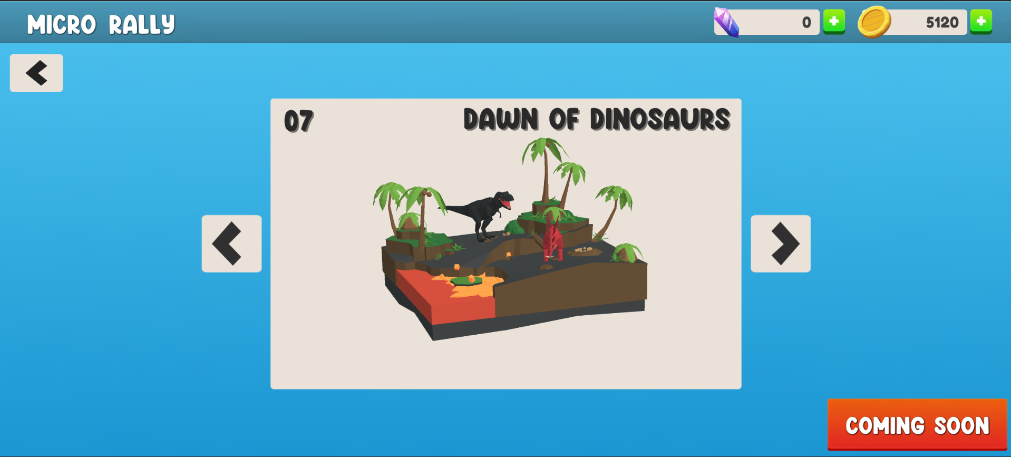
In app walkthrough

Slide 7
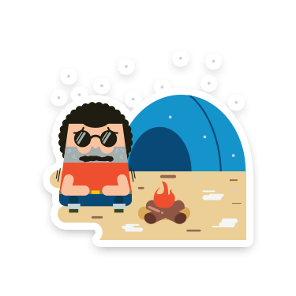
Marketing strategies

Slide 8


Marketing Objectives
Increase Brand Awareness
Enter to the International Markets
Increase Customer Base
Increase Revenue

Slide 9

Growth Rate
The following rates represent the growth of our competitors in the past year.
Competitor | Revenue (last month) | Price | Released date | Downloads
Dr.Driving | $1K | FREE | 19/06/2013 (approx. 9 years) | 3.3M
Hill climbing racing | $45.9K | FREE | 22/09/2012 (approx. 10 years) | 6.2M

Slide 10

Advertising Strategies
Google & YouTube Ads
Social Media Campaigns
(Facebook, Instagram)
Campaign Launch Event

Slide 11

Target Audience Percentages

Slide 12
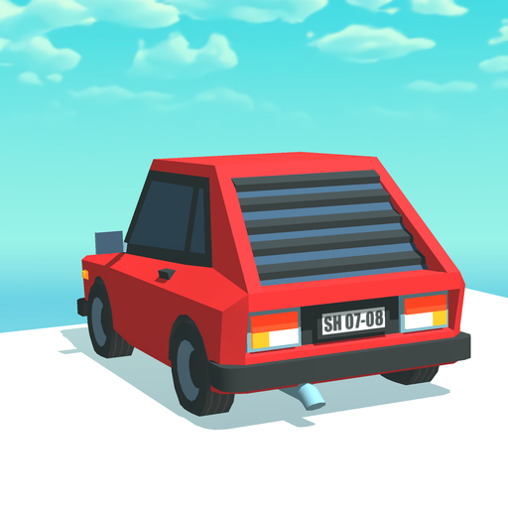



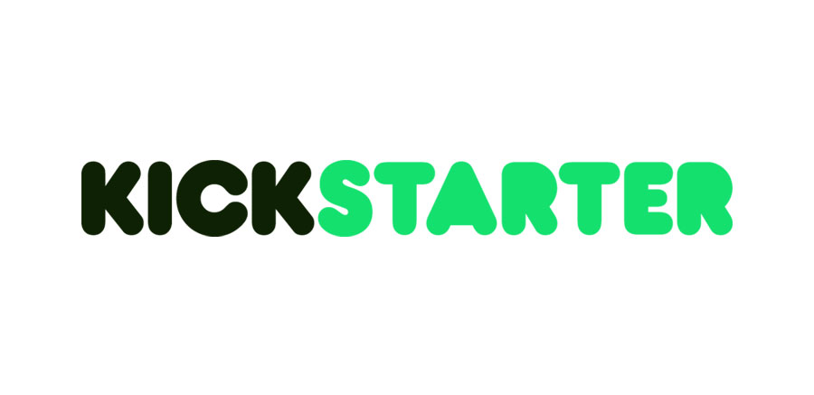
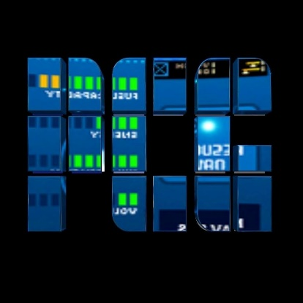
Strategy 3 crowdfunding
Marketing & Investors
Strategy 1
advertising
Strategy 2
influencer

Slide 13

Scalability & Application Analysis

Slide 14
O
SWOT
Opportunities
AIESEC
Strengths
Skillful labor and experience game developer
S
T
Threats
Competitors
Dr. Driving
#Driving
Hill climb race
Weaknesses
Limited labor and lack of decision making skills and negotiating skills
W

Slide 15

Future plans
user engagement by 20%
monthly revenue by 5%
target audience by 50%

Slide 16

Thank you
Do you have any questions ?

